Slide 1
USB and FireWire
Tom Rethard
illustrations from www.howstuffworks.com

Slide 2
USB Devices
Printers
Scanners
Mice
Joysticks
Flight yokes
Digital cameras
Webcams
Scientific data acquisition devices
Modems
Speakers
Telephones
Video phones
Storage devices such as Zip drives
Network connections
CD-RW

Slide 3
FireWire Devices
Cameras
Disk drives
CD-RW

Slide 4
USB Characteristics
127 devices per port
12-480 Mbps, depending on level

Slide 5
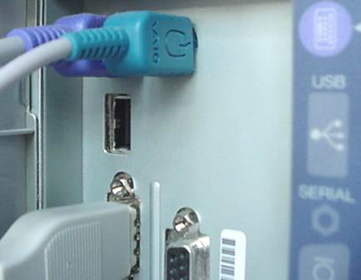
USB Socket
The rectangular socket is a typical USB socket on the back of the computer.

Slide 6
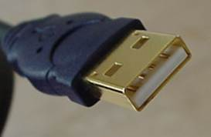
USB Cables
A typical USB connector for a device, called an "A" connection

Slide 7
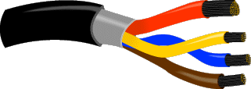
Cable Wiring
There are two wires for power -- +5 volts (red) and ground (brown)
Twisted pair (yellow and blue) of wires to carry the data.
The cable is also shielded

Slide 8
Cables
Many USB devices come with a built-in cable with an "A" connector
Otherwise, it has a USB "B" socket

Slide 9
"A" and "B" connectors
"A" connectors head "upstream" toward the computer.
"B" connectors head "downstream" and connect to individual devices.
Think “DTE” and “DCE”

Slide 10
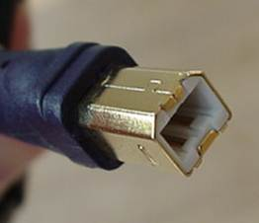
“A” and “B” Connectors

Slide 11
Auto-detection
OSs auto-detects new devices (required)
computer activates and uses it.
can be connected and disconnected at any time.

Slide 12
Hubs
Hubs are a part of the standard.
A typical USB four-port hub accepts 4 "A" connections. Typical hub: four new ports
May be chained together
Powered or Unpowered
  low-power devices like mice and digital cameras
  power (up to 500 milliamps at 5 volts)

Slide 13
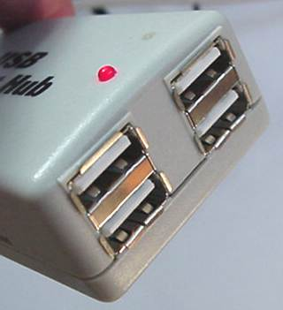
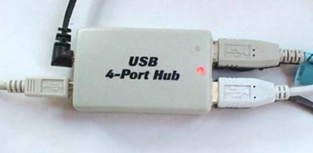
Hubs

Slide 14
Features
computer acts as the host.
Up to 127 devices can connect
USB cables as long as 5 meters; with hubs, devices can be up to 30 meters
bus has a maximum data rate of 12 megabits per second.
individual device up to 6 megabits per second.
USB devices are hot-swappable
Many USB devices have a sleep mode

Slide 15
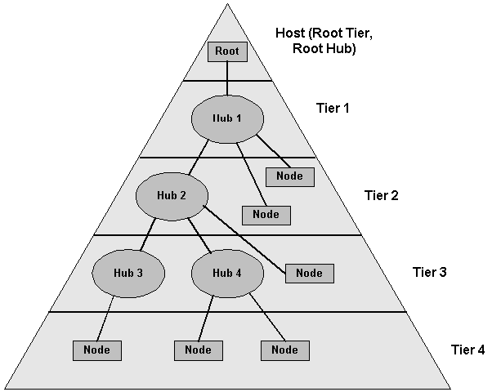
Example USB Hierarchy

Slide 16
Power On
host powers up
host queries all of the devices connected to the bus and assigns each one an address. (enumeration)
host discovers what type of data transfer it wishes to perform:
  Interrupt – For low data volume (mouse or keyboard)
  Bulk – For large blocks of data, as to a printer.
  Isochronous - A streaming device (such as speakers) uses the isochronous mode. Data streams between the device and the host in real-time, and there is no error correction.
host can also send commands or query parameters with control packets.

Slide 17
Enumeration
host tracks the total bandwidth that all of the isochronous and interrupt devices are requesting.
  allowed up to 90 percent of the 12 Mbps of bandwidth
After 90 percent is used up, host denies access to any other isochronous or interrupt devices.
Control packets and packets for bulk transfers use any bandwidth left over (at least 10 percent).

Slide 18
Frames
Bandwidth divided into frames, controlled by the host
Frames contain 1,500 bytes
New frame starts every millisecond
During a frame, isochronous and interrupt devices get a slot so they are guaranteed the bandwidth they need
Bulk and control transfers use whatever space is left.

Slide 19
USB 2.0
Increased speed
Backward compatibility
Released in 2001
Readily available this year
Performance similar to FireWire
Maximum data rate of 480 Mbps

Slide 20
Firewire

Slide 21
History
originally created by Apple
standardized in 1995 as IEEE-1394 High Performance Serial Bus
similar to Universal Serial Bus (USB)
design preceded the development of USB!

Slide 22
Goals:
Fast transfer of data (up to 400 Mbps)
Lots of devices on the bus
Ease of use
Hot pluggable
Provide power through the cable
Plug-and-play
Low cabling cost
Low implementation cost

Slide 23
Basics
Power up
  queries all of the devices connected to the bus
  assigns each one an address (enumeration)
FireWire is plug-and-play and hot-pluggable

Slide 24
Basics
64-bit fixed addressing, based on the IEEE 1212 standard
  A 10-bit bus ID that is used to determine which FireWire bus the data came from
  A 6-bit physical ID that identifies which device on the bus sent the data
  A 48-bit storage area that is capable of addressing 256 terabytes of information for each node!
Node Id
  bus ID and physical ID
  allows for 64,000 nodes on a system

Slide 25
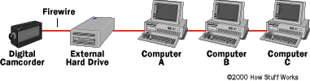
You Can’t Do THIS w/ USB!

Slide 26
Key differences:
FireWire is intended for devices working with a lot more data
USB 2.0 is host-based, meaning that devices must connect to a computer in order to communicate.
FireWire is peer-to-peer, meaning that two FireWire cameras can talk to each other without going through a computer.

Slide 27
1394 Architecture
Two bus categories
  Backplane
    Supplement to parallel bus structures with serial path
  Cable
    non-cyclic network with finite branches
  Nodes
Each node usually has three connectors
standard provides for 1-27 connectors per device

Slide 28
1394 Architecture
Up to 16 nodes can be daisy-chained with standard cables up to 4.5 m in length for a total standard cable length of 72 m.
Using higher-quality "fatter" cables permits longer interconnections

Slide 29
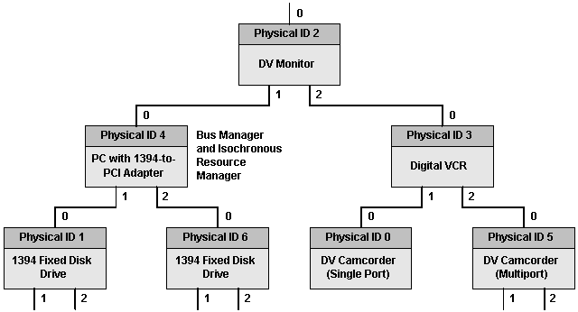
Sample PC-based Firewire

Slide 30
Physical, Link, and Transaction Layers
The 1394 protocol is implemented by the three stacked layers shown in the next slide. The three layers perform the following functions:
  The transaction layer implements the request-response protocol
  The link layer supplies an acknowledged datagram to the transaction layer.
  The physical layer provides the initialization and arbitration services necessary to assure that only one node at a time is sending data and to translate the serial bus data stream and signal levels to those required by the link layer.

Slide 31
Cables
Individual as long as 4.5 meters
Data sent through up to 16 hops (distance of 72 meters max)
6-conductor cable
  2 power conductors in cable (8 to 40 volts, 1.5 amps maximum)
  2 separately-shielded twisted pair transmission lines for signaling
  Overall shield
Connectors are derived from the GameBoy design!

Slide 32

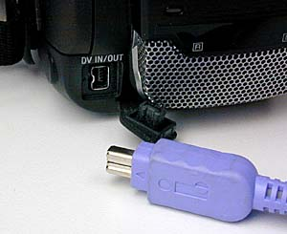
1394 cables and connectors.

Slide 33
1394 Bus Management
Three services:
  A cycle master that broadcasts cycle start packets (required for isochronous operation)
  An isochronous resource manager, if any nodes support isochronous communication (required for DV and DA applications)
  An optional bus master (usually a PC adapter, but an editing DVCR might act as a bus master)

Slide 34
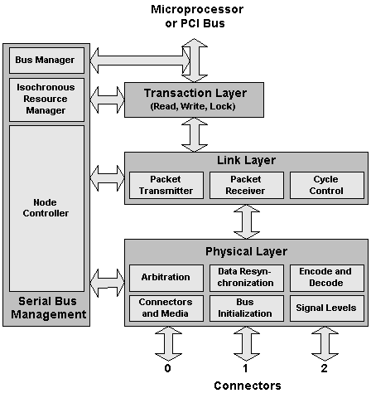
Bus Management

Slide 35
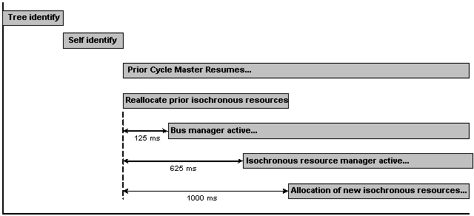
Bus reset timeline.

Slide 36
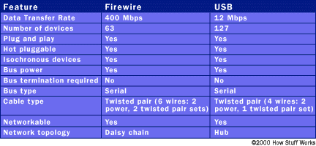
Comparison.

